Slide 1
PlantMinder
Kevin Bang
Joon Choi

Slide 2
Overview
Problem
Importance
Solution

Slide 3
Requirements
Hardware
Woods
Valve
Hose
Survos
Arduino + breadboard
3D Printer
Software
Arduino
Solidworks

Slide 4
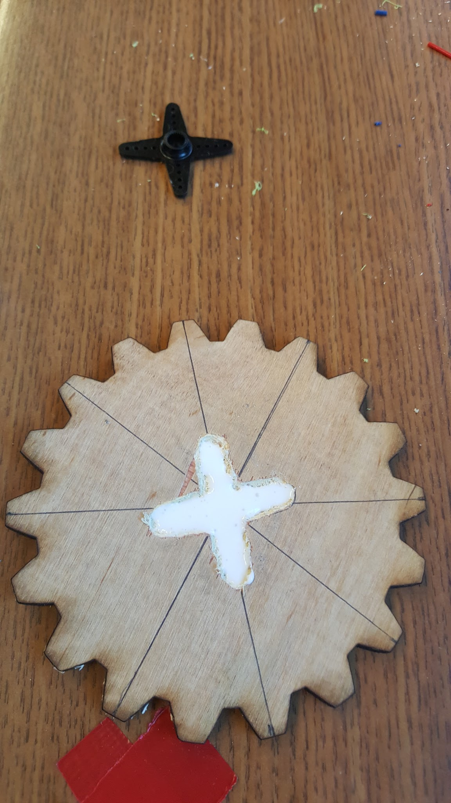
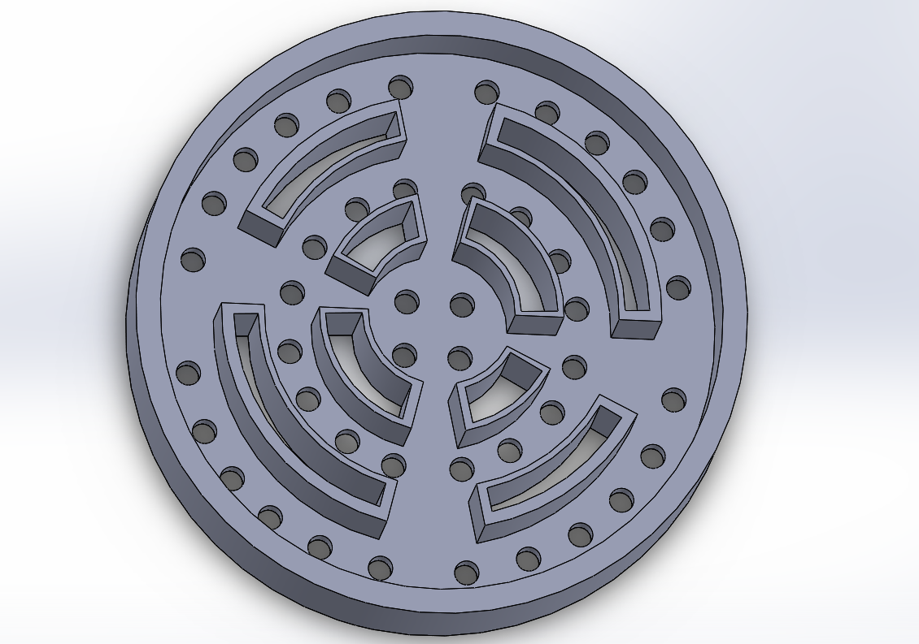

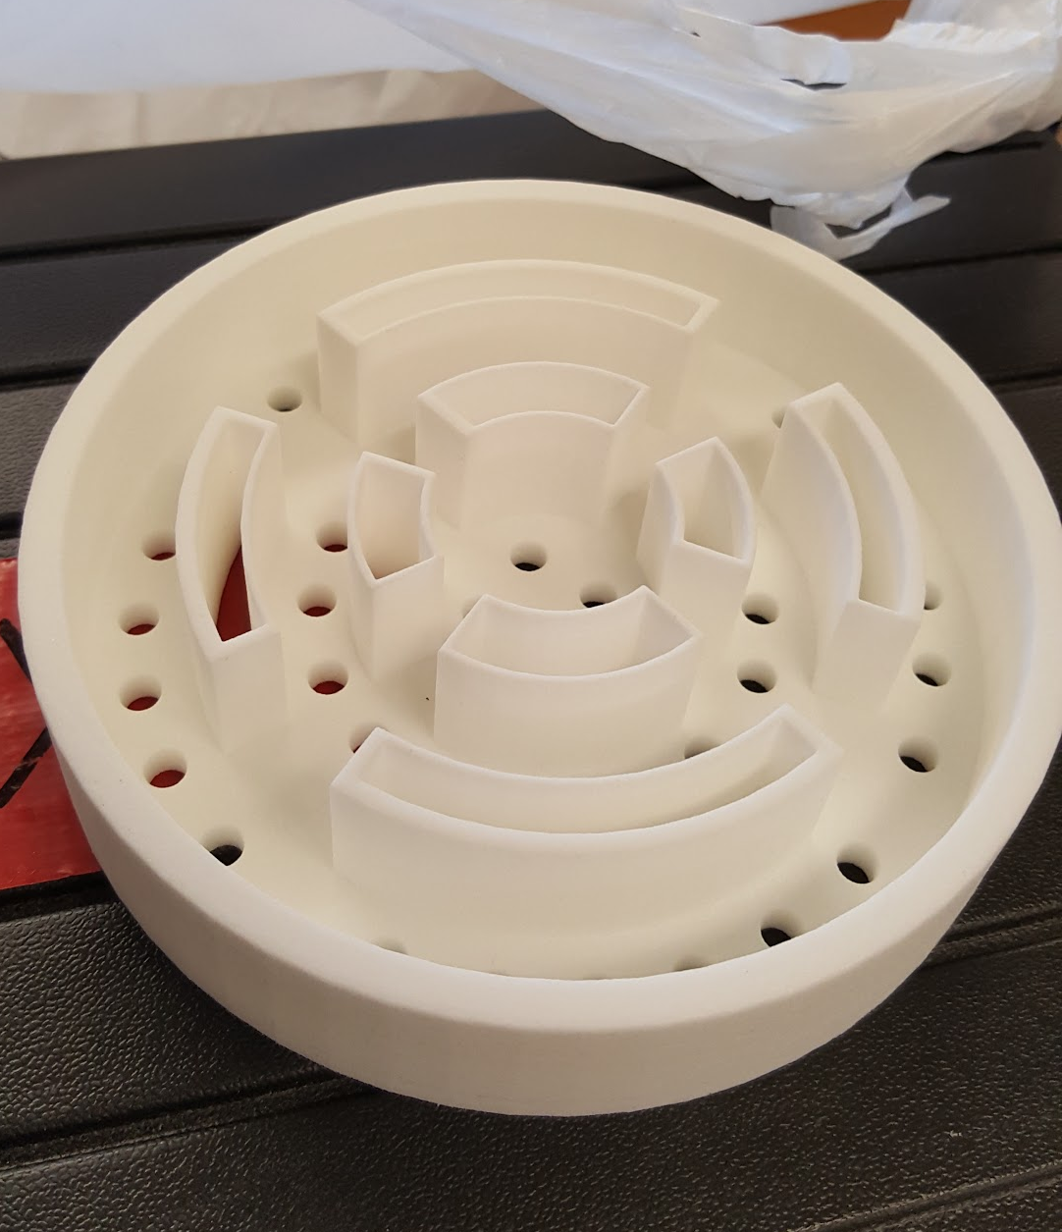
Hardware Architecture
(put picture of solidwork design)
Maybe also put picture of survos here
Notes:
Explanation about why we printed this,
What was the purpose,
How it worked?
Maybe?
And explain about how we worked with survos
And gear.

Slide 5
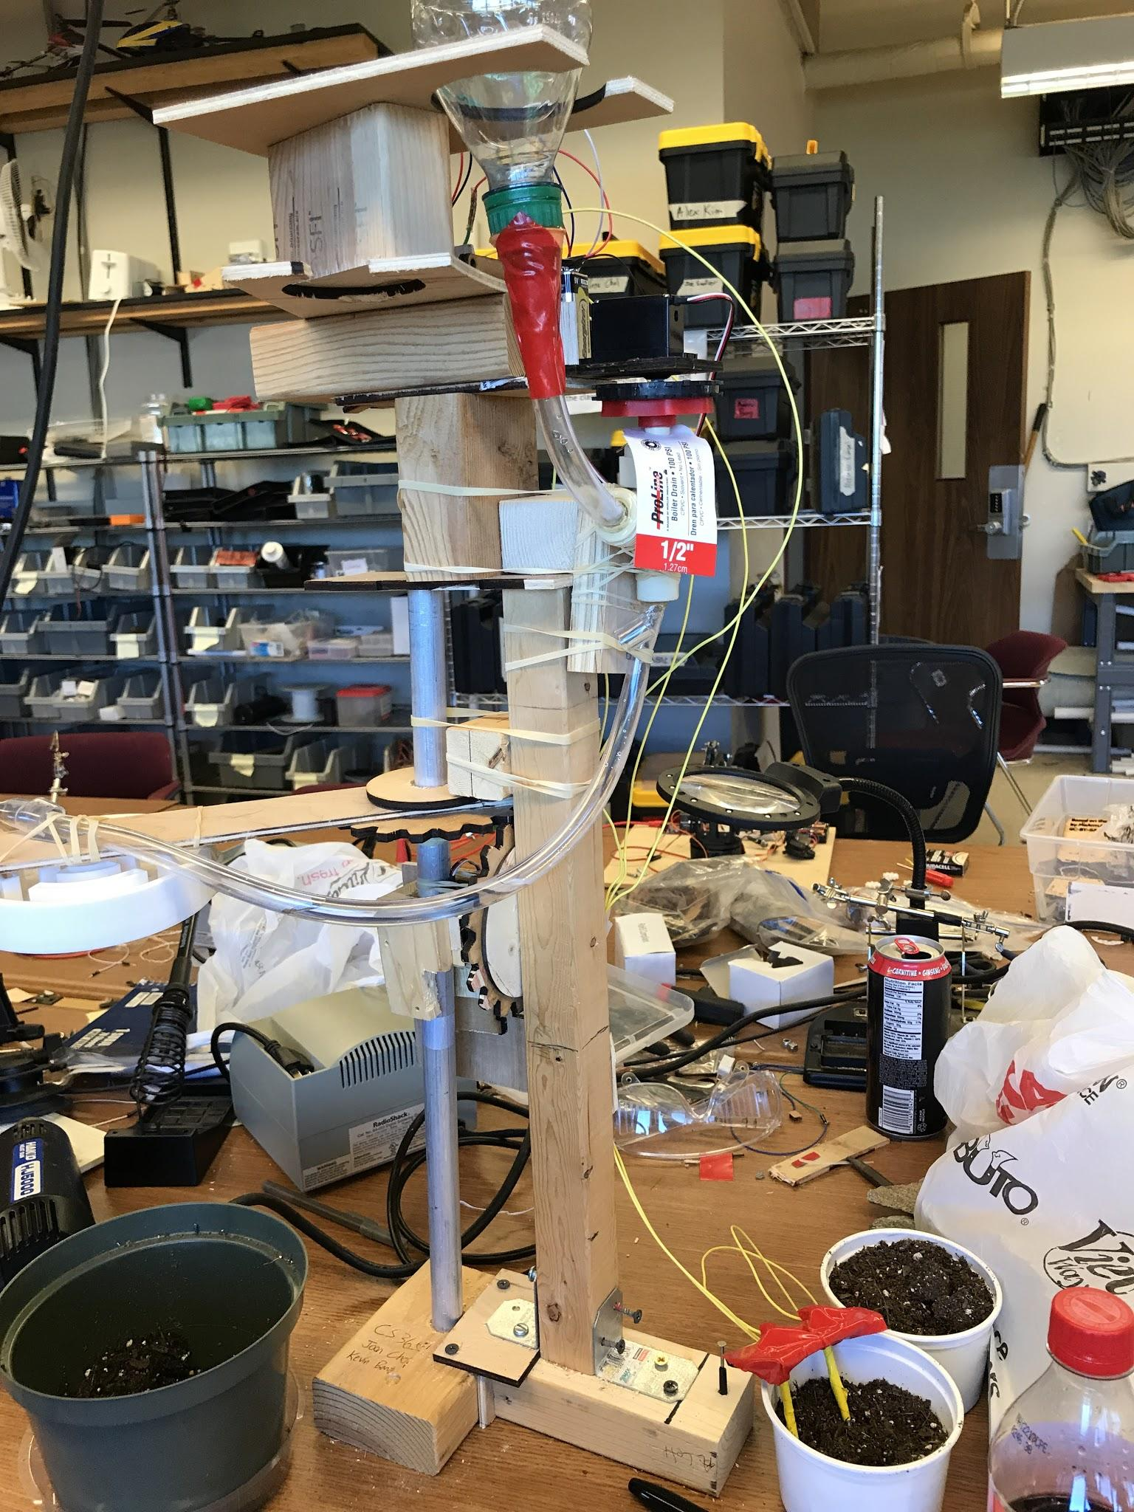
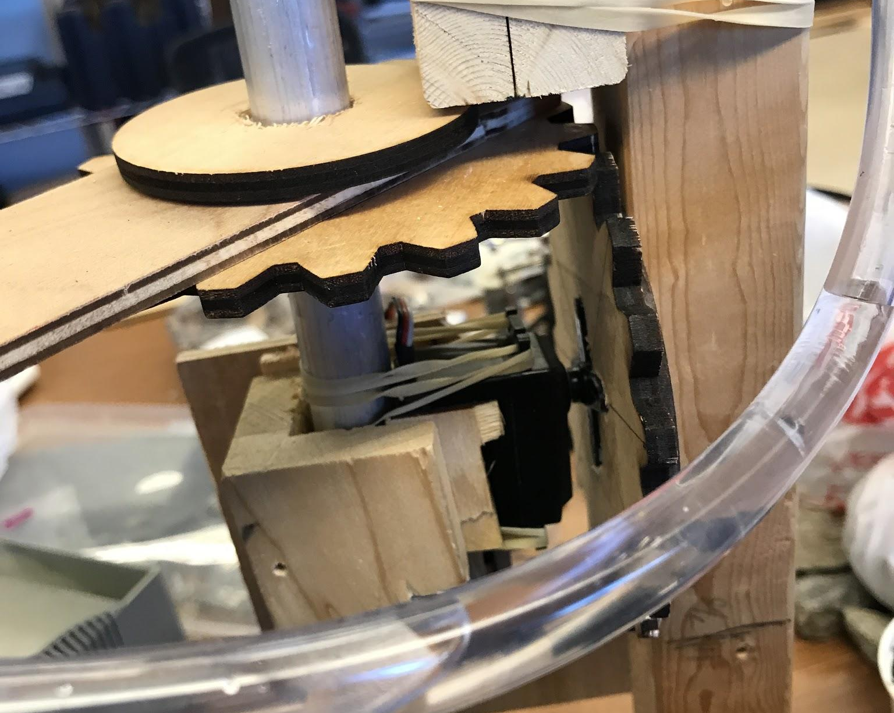
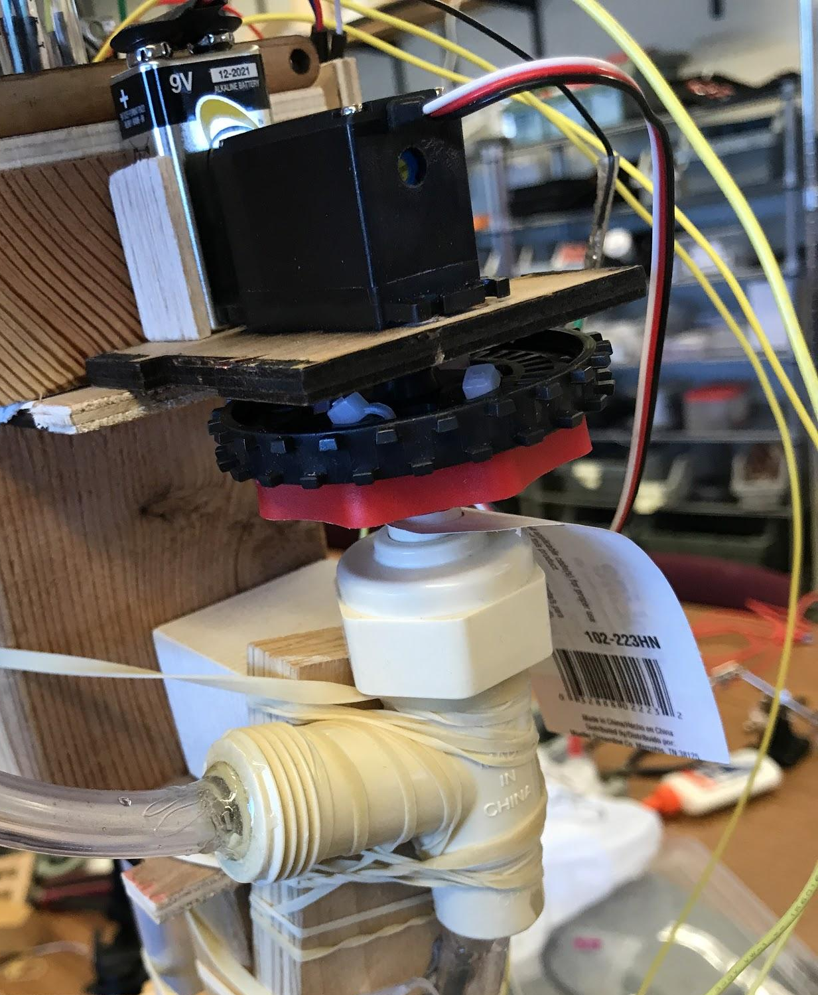
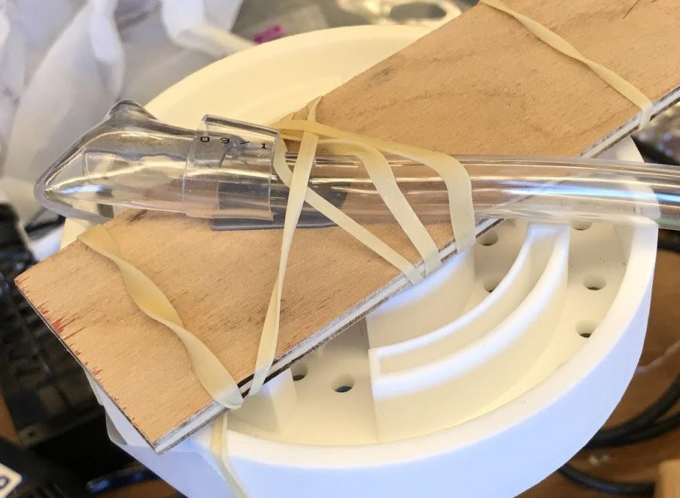
Hardware Architecture

Slide 6
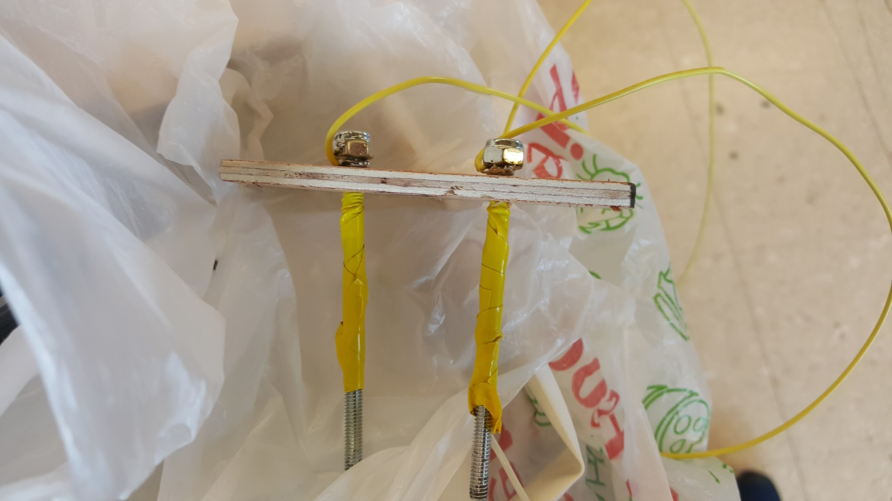
Software
Moisture Sensor

Slide 7
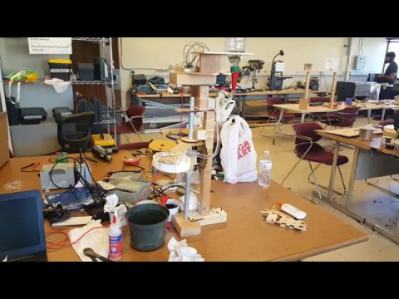
Demo

Slide 8
Challenges
Servos
Gears
Tube flexibility
Moisture sensor inaccuracy
Short on time

Slide 9
Looking Back
Should’ve been prepared for mishaps
3D print sooner

Slide 10
Moving Forward
3D printing the main structure would allow for a smoother construction
Find more flexible tubes
Change out the valve to be an electrical valve to not rely on our own constructed valve turner (the servo)

Slide 11
Questions?

